Slide 1
Centres of Excellence
Research Strategy and Portfolio Planning
J.D. Linton, Editor-in-Chief of Technovation and Power Corporation Professor for the Management of Technological Enterprises
University of Ottawa

Slide 2
Centres of Excellence – Traditional Approach
Physically co-locate people and infrastructure
Specific areas of science/technology
Specific infrastructure
Mission oriented: different skills same mission

Slide 3
Integrating Nature of Information and Communication Technologies
Removes many barriers associated to distance
Note: does not eliminate the value of proximity
Allows dispersal of personnel
Allows leverage of existing resources – regardless of location

Slide 4
Networks of Excellence
But what should one network?
What should one create?
What should one maintain?

Slide 5
Portfolio Approach
What do we currently have and where is it?
Avoid over replication/duplication
Where are the gaps that should be filled?
Where are the synergies?
How do the skills relate to each other?
Are there core competencies?
Are we maintaining old competencies?

Slide 6


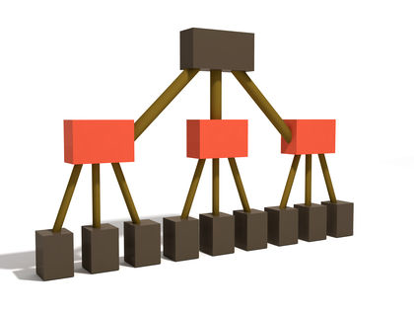
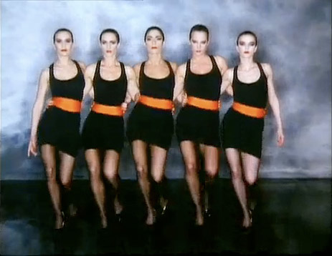
Considering Inter-Relations
Independent
Replacement
Interdependent
Synergistic
Correlation
http://3.bp.blogspot.com/-fXEKwjcLuS0/TjbaBG88giI/AAAAAAAAAgE/CR2HiCUpe0Q/s1600/robert-palmer-girls.jpg
http://www.referenceforbusiness.com/photos/channels-of-distribution-166.jpg
http://www.masterinternationalcommunication.eu/wp-content/uploads/2012/05/synergy-7661.jpg
http://www.h2euro.org/wp-content/uploads/2010/11/independent.jpg
Notes:
Pictures needed here

Slide 7
Understanding What We Have
  What we have versus What we should have
  - Identifying the gaps
  Where is co-location valuable?
  Where is separation valuable?

Slide 8
Understanding Which Linkages to Change
Where is redundancy valuable?
Where is coordination valuable?
What is related and what is independent?

Slide 9
In Conclusion
ICT Changes the nature of Centres of Excellence
Now it is easier to be more strategic
Not advocating central planning
Advocating avoidance of herd behaviour or pursuing fads and fashion

